Slide 1
Measurement
Rule up 3 column notes!
Topic: Area
EQ: How do we work out the area of basic shapes?
Mrs Stretch
Year 8

Slide 2
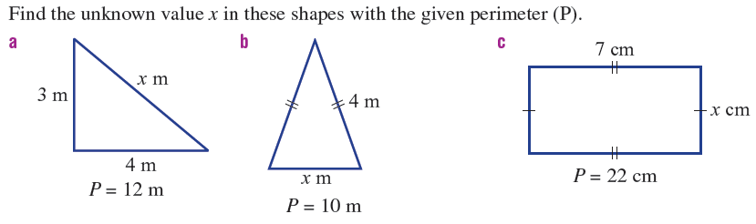
Last Lesson Re-Cap

Slide 3
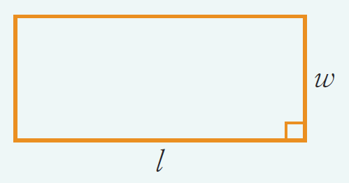
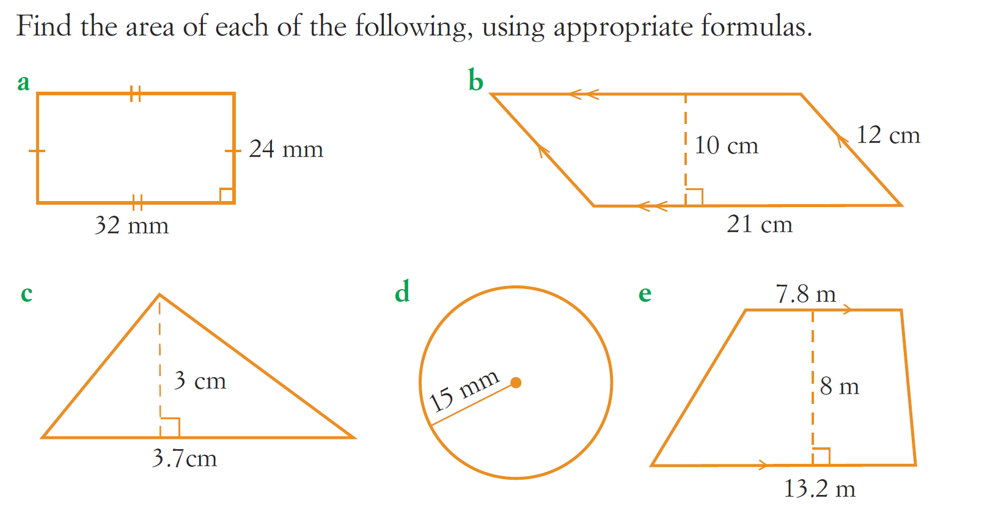
24
7
30
Area
Date
EQ – How do we work out the area of basic shapes?
Examples
Steps
Rectangle

Slide 4
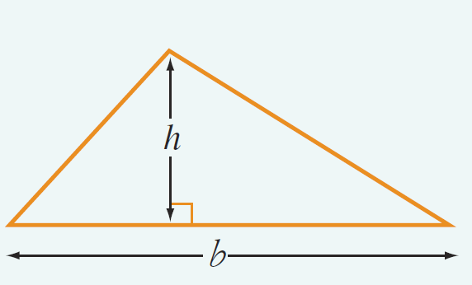
24
7
30
Area
Date
EQ – How do we work out the area of basic shapes?
Examples
Steps
Triangle

Slide 5
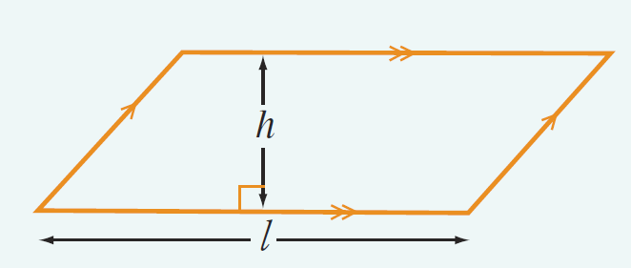
24
7
30
Area
Date
EQ – How do we work out the area of basic shapes?
Examples
Steps
Parallelogram

Slide 6
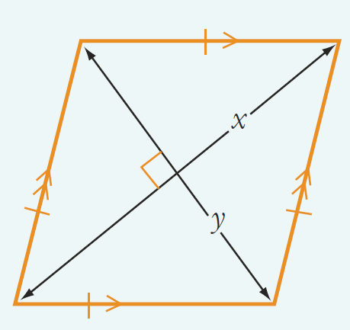
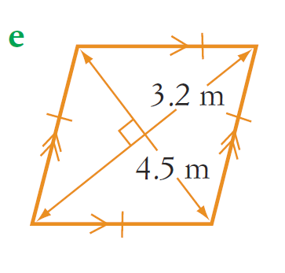
24
7
30
Area
Date
EQ – How do we work out the area of basic shapes?
Examples
Steps
Rhombus

